Slide 1
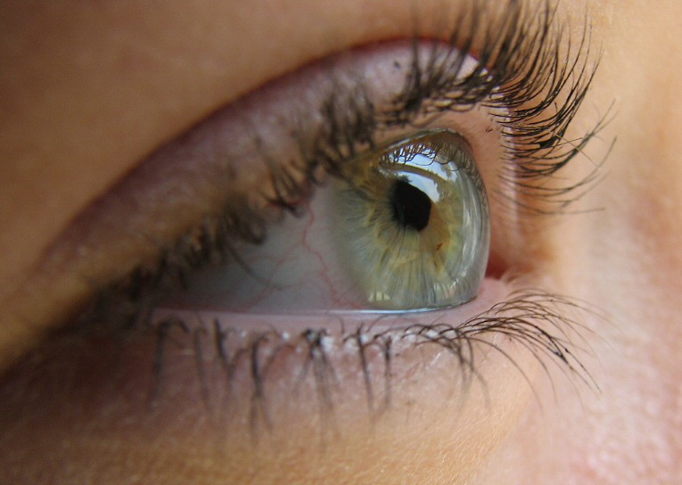
Visual Judgment Experiment Answer Key
Trial 1 – A – say B
Trial 2 – B – say C
Trial 3 – C – say B
Trial 4 – A – say C
For 5 times in a row do it this way everyone in the class – one at a time
For the last 5 change it up and have someone choose the correct answers

Slide 2
Trial 1
Exhibit 1
Exhibit 2
A B C

Slide 3
Trial 2
Exhibit 1
Exhibit 2
A B C

Slide 4
Trial 3
Exhibit 1
Exhibit 2
A B C

Slide 5
Trial 4
Exhibit 1
Exhibit 2
A B C

Slide 6
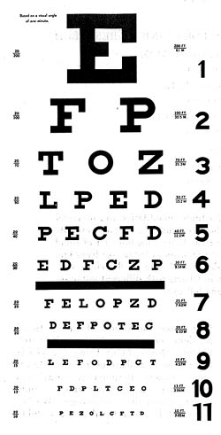
Thanks for participating

