Slide 1
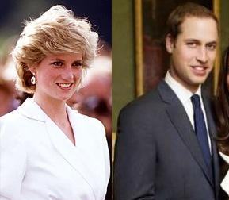
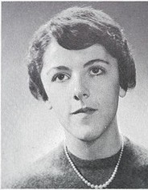
Psychology & Socialization: The Development of Self
Heredity versus Environment
Twins * Adoptions * IQ * Siblings Studies

Slide 2
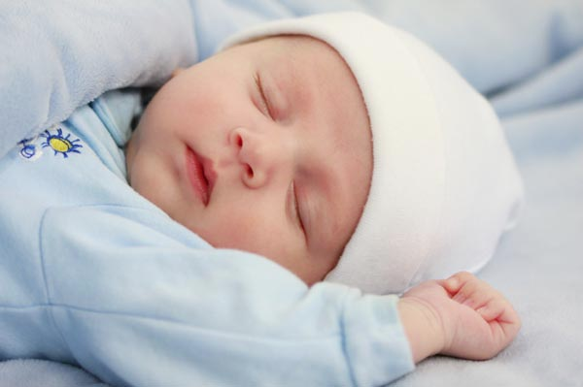
How do we become who we are? Is our personality within us at birth or shaped by the people in our lives?

Slide 3
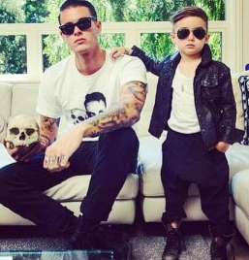
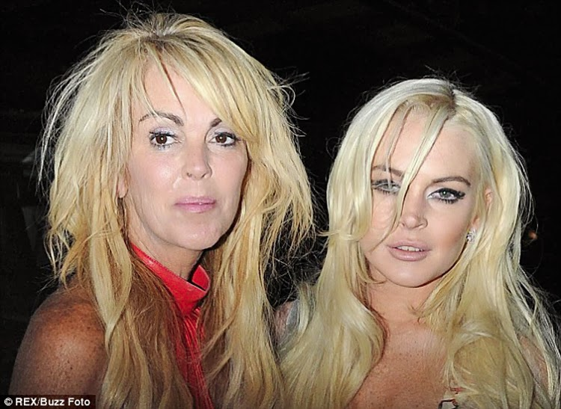
Pardon my language, but what makes an A#@ H--- an A#@ H--- ?

Slide 4
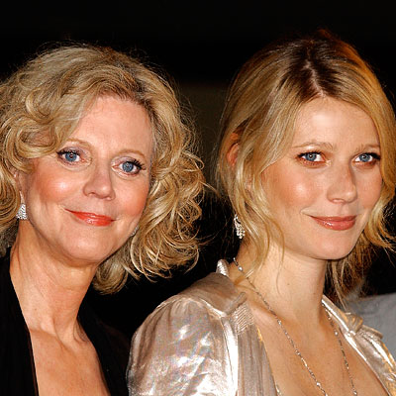
Conversely, what makes a grounded, successful person?

Slide 5
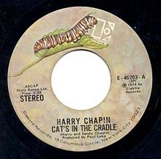
Is it our genetic makeup or our social environment?
Nature versus Nurture
Heredity versus Environment

Slide 6
work sheet

Slide 7
Heredity
Heredity refers to physical characteristics and aspects of your personality and behaviour that are part of your genetic structure
We inherit these from our biological relatives
If both your parents are left handed you are more likely to be

Slide 8
Environment
Many factors in our environment can influence our development as well
Family, peers, socioeconomic background, culture, birth order, level of education, type of education and so on

Slide 9
The Edith Experiment
The Edith experiment was created by Aaron Stern, and he tried to prove that the right environment could create a genius his daughter Edith was the subject of the experiment
Stern played classical music and showed flash cards to Edith since birth
by 5, Edith could read the encyclopaedia Britannica, and had a PhD by 18

Slide 10
Does this prove that a genius can be made? What factors should we consider before coming to this conclusion? Talk to someone else for a moment and then write something please so you have something to look back on

Slide 11
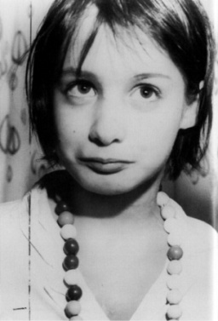
The Genie Wiley Story
Genie (real name Susan) was found at the age of 13
She had been raised since birth locked in a room, no one talked to her, she was neglected and abused
She appeared developmentally delayed, and psychologists wondered if she was born this way or turned out this way due to neglect

Slide 12
John Wiley
This is Genie’s brother John
He lived in the same home but was less neglected by his parents

Slide 13
What does Genie’s story tell us about heredity versus environment? What factors are involved in this story?
Talk to someone else for a moment and then write something please so you have something to look back on

Slide 14
How can we sort this out?

Slide 15
Twin Studies
twins are two people who are born in the same pregnancy—they can be identical or fraternal
psychologists study both identical and fraternal twins to understand the influence of environment and heredity
the theory for identical twins was that any difference could be explained to environmental factors (since identical twins have the same genes – one embryo literally splits into two)
however, new research shows that’s not the case—in female twins, each twin has two X chromosomes, and in females one chromosome is more dominant than the other (chances are, twin females have different dominant chromosomes, meaning they’re not genetically similar)

Slide 16
Twins Raised Apart
twins that were raised apart are used to determine what aspects of personality are inherited (because they were raised in different environments, similarities could only be from genetics)
in one example, the “Jim” twins had much in common—they both drove the same car, had the same interests, named their dog the same, married women of the same name, vacationed in the same places etc.
Mark and Jerry, fire fighters

Slide 17
Limitations of Twin Studies
there are limitations to twin studies—behaviour involves many genes, and it’s difficult for researchers to determine which behaviours have genetic tendencies
research shows that some characteristics are more likely to be inherited—height, weight, shyness~

Slide 18
IQ & Genetics
twins tend to have the same IQs—but it’s hard to tell if their intelligence level is due to environment or genetics because twins have the same genetics and are raised in the same environment typically (the same house) however, twins who were raised apart still have similar IQs (higher when raised together though)
adoptive children have more similar IQs with their biological parents than with their adoptive parents
this tells us that genetics may play a big role

Slide 19
IQ & Environment
environmental influences can affect IQ scores— improved schooling, housing, & nutrition in the USA, have impacted IQ scores positively, and since the genetics haven’t changed, it must mean that the environment Americans are being raised in are better (high quality homes, smaller family sizes, nutrition)
also, twins raised together have much more similar IQs than twins raised apart (meaning environment is a big influence)

Slide 20
What about my siblings?
We’re so different!

Slide 21
Siblings Similar but Different!
If you have the same parents and grow up in the same house, how can you be so different?
Using twin and adoption studies we see that genetics account for approximately 50% of differences in traits such as extroversion and emotional instability
However, psychologists believe that the other 50% can be explained by the fact that even though they are potentially genetically similar and grow up in the same home, they have unique experiences outside the home and even with their parents, each impacted by interactions and personalities

