Slide 1
5 Factors that Affect Conformity

Slide 2
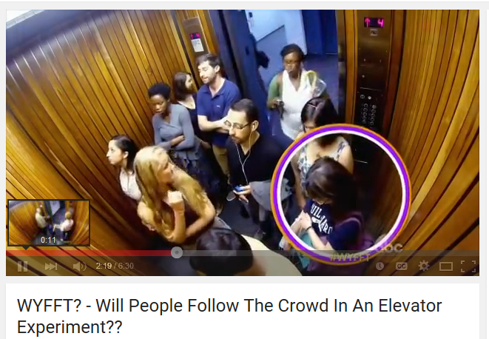
Minds on…

Slide 3
Why do you think people conform?
Possible answers?
To fit in
To be liked
Everybody else is doing it
Other reasons?

Slide 4
1) Group Attractiveness:
The more attractive the group is to its members, the more likely the members are to conform.
The lower the social position of the individual member in the group, the more that person can be influenced to conform to the group

Slide 5
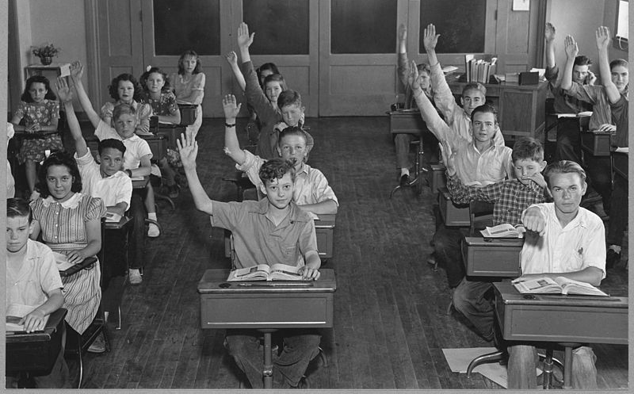
2) Group Unanimity:
Groups that are unanimous or in total agreement can exert great pressure to conform.
When even one person has a dissenting view in a group, the pressure to conform to the group’s view is reduced considerably.

Slide 6
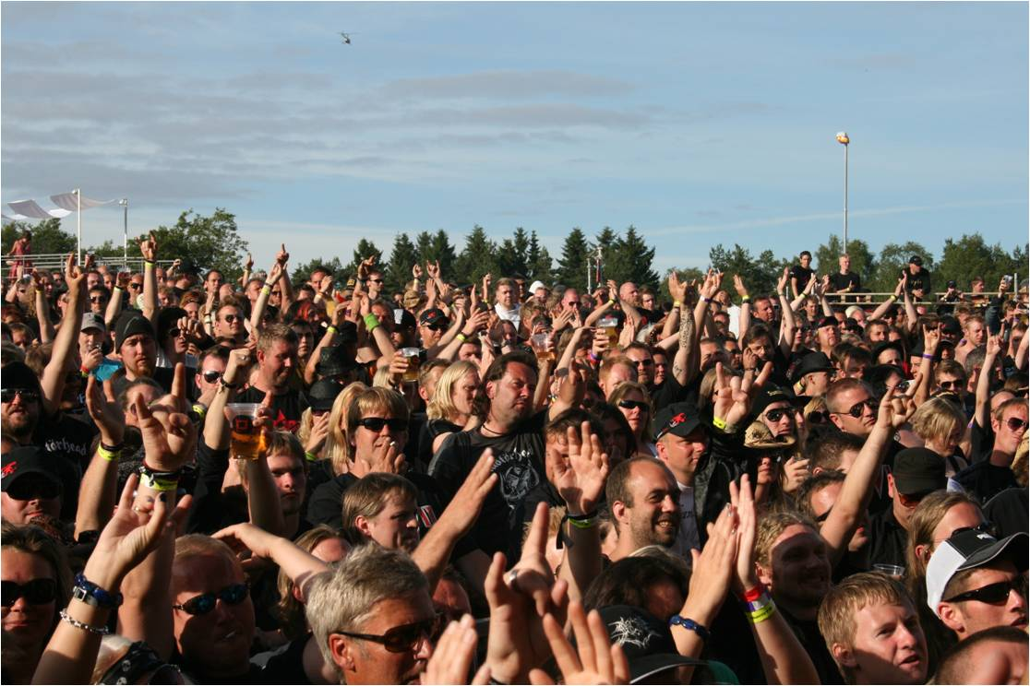
3) Public vs. Private Response:
When group members have to express their views in front of others, they are most likely to conform than if they could do so in private, such as by filling out an opinion survey.

Slide 7
4) Nature of the task:
Tasks that are unclear or that people do not feel competent at, make it easier for people to conform.
When they are clearer, factual, or on a topic you feel competent about relative to the group, you are less likely to conform.

Slide 8
5) Self Esteem
Those with lower self esteem are more likely to conform because they want to belong.
Participants are less likely to conform when they are confident in themselves or their abilities

Slide 9
Asch experiment:

Slide 10
Milgram experiment:

Slide 11
Zimbardo Stanford Prison Experiment:

