Slide 1
Ethnocentrism and Anthropology
Not a good mix!

Slide 2
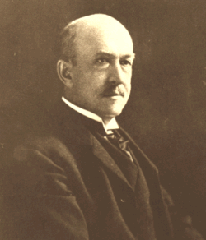
Ethnocentrism Defined
Ethnocentrism is the tendency to believe that one's ethnic or cultural group is the most important, and that all other groups are measured in relation to one's own.
The ethnocentric individual will judge other groups relative to his or her own particular ethnic group or culture, especially with concern to language, behaviour, customs and religion
The term was made up by William G. Sumner, while observing people differentiate between in group and others, he described it as leading to pride and superiority and contempt of outsiders

Slide 3
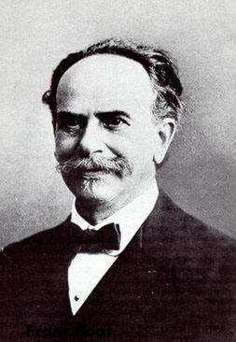
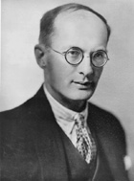
Anthropologists
Franz Boas
Bronislaw Malinowski
Both argued that any human science had to rise above the ethnocentrism of the social scientist
Both urged anthropologists to conduct ethnography in order to get over this
Boas developed the idea of “cultural relativism” stating that each culture developed relative to its own experiences and geography as well as “historical particularism” meaning each culture had its own history that helped to create its customs and ways
Malinowski also argued that cultures various customs and behaviours function to meet the specific needs of the people of that culture

Slide 4
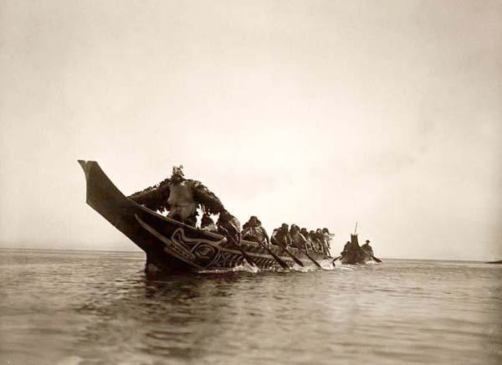
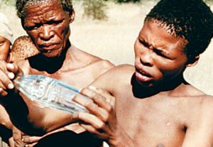
Essentially, if you lived among a group of people with an open mind you would learn that different doesn’t mean less than, and you would see that people have different ways because of different needs and histories
Differences exist because of different pasts and experiences as each group “develops” independently (prior to contact with a dominant culture anyway)
This challenged the racist, old school thinking that all ‘primitive’ cultures were less developed than ours on an evolutionary scale

Slide 5
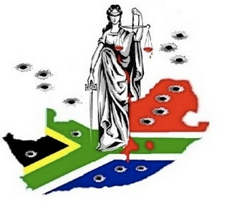
Boas who worked from the late 1800s to the mid 1940s was the first social scientist in America to state that all humans really are equal and that race doesn’t matter
The first to challenge the racism that existed in the colonialist practices of Anthropologists
Who basically excused slavery and exploitation and stealing of indigenous lands by placing white Europeans at the top of the evolutionary scale
in order to justify what was happening around the world

