Slide 1
Psychology 101
Theories: Explaining Human Behaviour

Slide 2
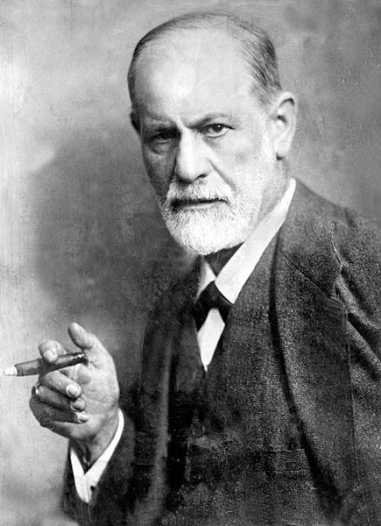
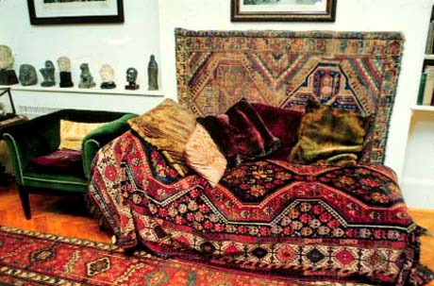
The Father of Psychology
Sigmund Freud (1856-1923) is known as the father of psychology.
Freud established a branch of psychology known as psychoanalysis.
He is the father of clinical therapy and his work is still considered very influential.
I will have a better understanding of some of the key psychology theories

Slide 3
Psychoanalysis
founded by Sigmund Freud
viewed human behaviour as being driven by the conscious and subconscious workings of the mind
the mind is controlled by three forces
believed you can uncover these subconscious or unconscious thoughts or urges by using free association, dream analysis, hypnosis etc.
humans are ruled by forces and drives
id
primitive drives
ego
reality based
superego
conscience
I will have a better understanding of some of the key psychology theories

Slide 4
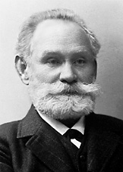
Early forms of Behaviourism
behaviour
behaviour
one of the founders is Ivan Pavlov
see classical conditioning
this is a theory about learning and conditioning
felt that actions and responses that can be observed should be studied or in other words behaviours
humans respond to different things (stimuli)
stimulus s > response r
(objects or events) (behaviour or action)
this is a relationship
Humans respond to stimulus with some type of behaviour
learning &
conditioning
I will have a better understanding of some of the key psychology theories

Slide 5
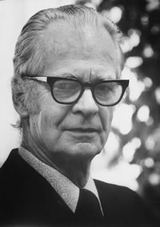
B F Skinner & Behaviourism
B.F. Skinner further looked at how behaviour is shaped based on rewards or reinforcements for the behaviour
Humans respond to reinforcements with more behaviour
behaviour + reinforcement = more behaviour
I will have a better understanding of some of the key psychology theories

Slide 6
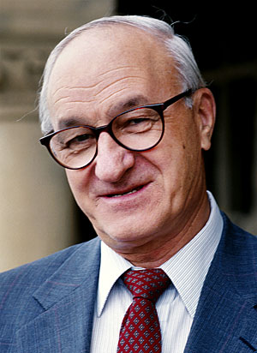
Social Learning Theory
one of the founders is Albert Bandura (modeling)
felt that learning occurs through the observation and imitation of models
this learning can be maintained through reinforcement (has its roots in behaviourism) which means that we can shape behaviours that are being learned by modelling desired behaviours and then rewarding them
I will have a better understanding of some of the key psychology theories

Slide 7
Social context is important…
goes beyond behaviourism and recognizes that the social context of learning is important and that humans influence their environment as well as being moulded by it
personal factors like beliefs and attitudes affect learning, behavioural factors include the response to a given situation – eg. fail a test > anger / or fail a test > work harder
environmental factors include the modelling of parents, teachers, and peers
humans are shaped by their interactions and particularly by learning socially through observation of behaviour and whether or not the specific behaviours are rewarded
I will have a better understanding of some of the key psychology theories

Slide 8
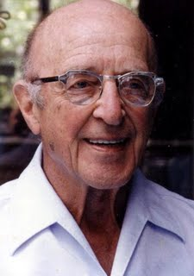
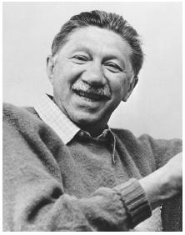
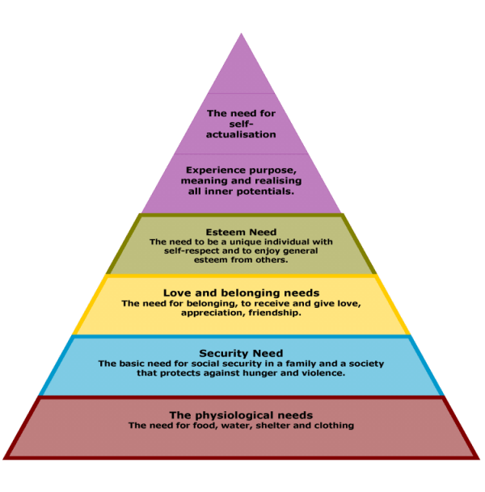
Humanism
Carl Rogers & Abram Maslow
look at the unique quality of human beings and their potential for personal growth
feel that people can take control of their lives and are not just ruled by drives and emotions (Psychoanalysts) or by the environment and stimuli (Behaviourists)
humans have needs but humans make choices regarding how to best satisfy those needs
I will have a better understanding of some of the key psychology theories

Slide 9
I will have a better understanding of some of the key psychology theories

Slide 10
Cognitive Psychology
look at the brain and mental processes involving memory/ learning/ thinking
we can monitor the brain to see what part is active when we talk, laugh, watch tv etc. technology has improved this area of study immensely
ex. MRIs
study the connections between how we think and how we feel
humans think and that thinking can be studied but it can also be shaped
I will have a better understanding of some of the key psychology theories

