Slide 1
Motivation & Human Behaviour
motivation is the study of why we do the things we do or the causes of our behaviour

Slide 2
Minds On…
What does this mean?
What implications does it have for helping us to understand what roles wants or needs play when it comes to motivating human behaviour?
What about feelings and emotions? How are they connected to wants and needs? Therefore, how do they affect human behaviour?
What about habits, impulses & intuition?

Slide 3
Human Behaviour…
What drives human behaviour?
Are we driven by our biological needs or our social needs?
Do you think it is a bit of both?

Slide 4
What do the theorists say?

Slide 5
What Motivates Behaviour?
Social Motivation
Biological Motivation
inborn or innate needs such as hunger
these needs are physical
they are derived by nature or genetics possibly through genetic pre-programming or predisposition such as personality
learned psychological needs
need for social approval such as praise & rewards encourages learned behaviours that are desired
these behaviours are driven by nurture or our social environment

Slide 6
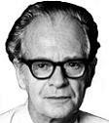
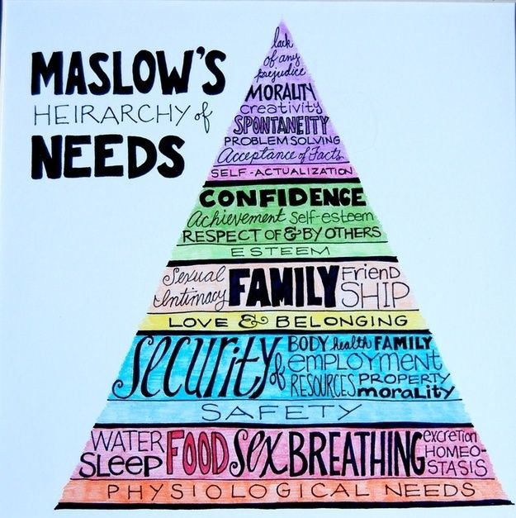
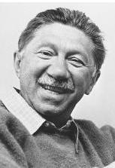
Nature versus Nurture?
Nature
Nurture
Freud, we are driven by our life and death drives
sexual drive
aggression
Watson, & Skinner, we are driven by a desire for reinforcement
praise from others
Both
Maslow, we are driven by basic physiological needs initially, but once they are met we are also driven by social needs
food, water, shelter
security
love and acceptance
recognition or esteem
self-actualization

Slide 7
What do you think?
Learning Goal: I will understand the difference between nature versus nurture and human regarding human motivation for behaviour

