Slide 1
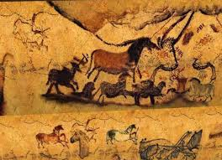
CAVE ART IN THE TIME OF THE NEANDERTHAL

Slide 2
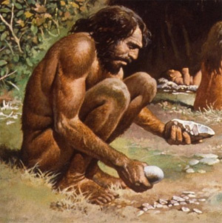
Going back about 100,000 to 40,000 years ago, our ancestors appeared to develop very little, making stone tools that were indistinguishable from those created by Neanderthals & living like them as early hunter-gatherers.

Slide 3
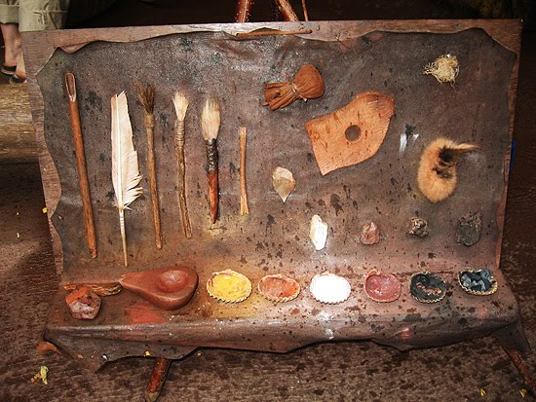
Then about forty thousand years ago made an enormous creative & cultural leap in the advancement of tool making and in the creation of art.

Slide 4
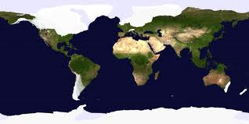
The most intense artistic activity happened just as the most recent Ice Age (approximately 40,000 - 15,000 years ago) reached its most severe period
then about 10,000 years ago, it virtually disappeared as we entered another interglacial period.

Slide 5
Within that 25,000 -year period – more than twelve times the age of Christianity – extraordinary cave art covered all of Europe, from Andalusia in Spain to the Ural Mountains of central Russia.

Slide 6
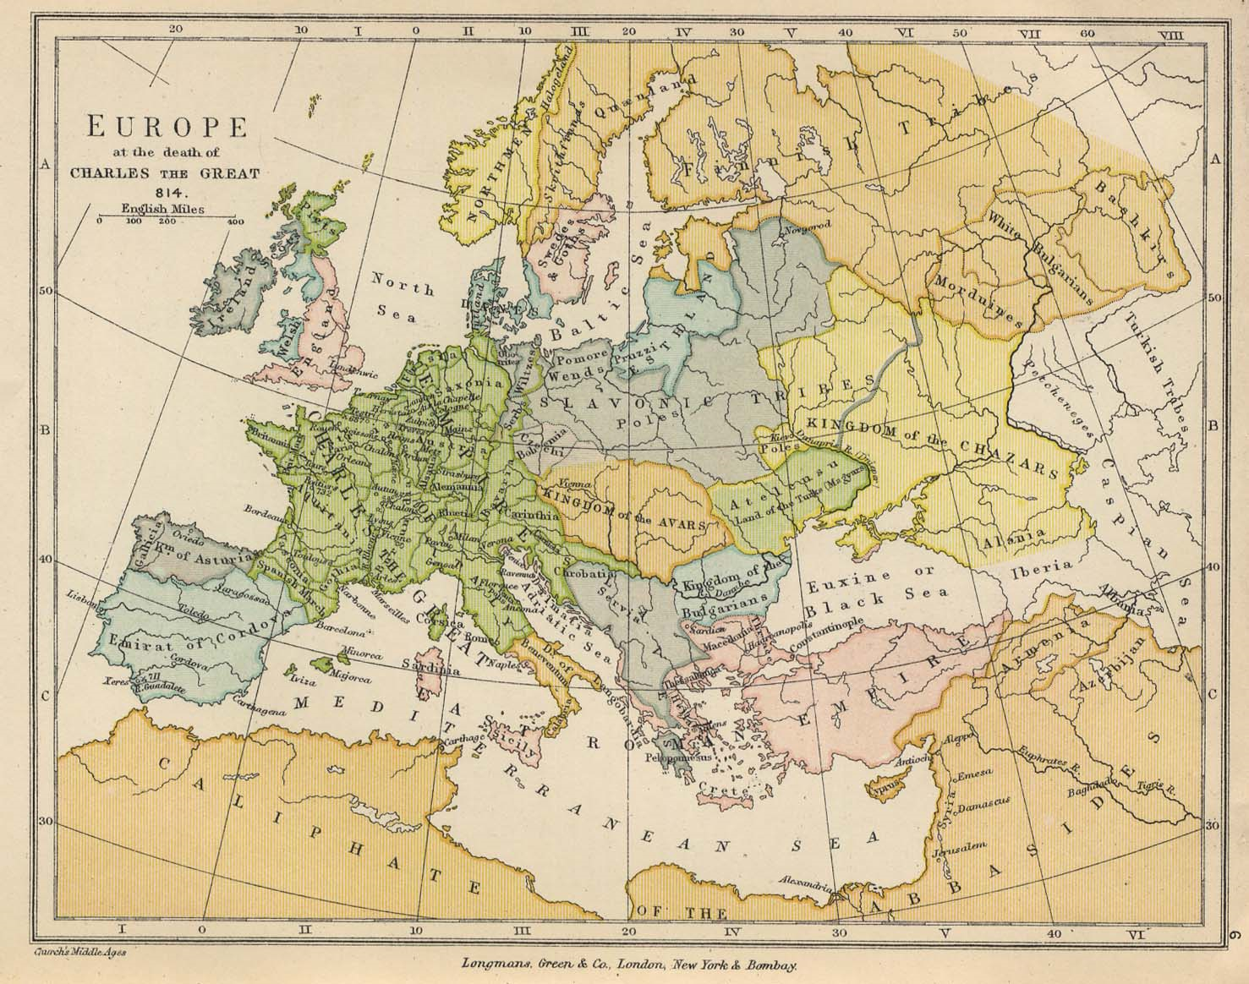
Ural Mountains Russia
Andalusia Spain
forward

Slide 7
Today we know of approximately three hundred sites, but scholars suggest there must have been thousands. Hopefully some have still to be discovered!!!

Slide 8
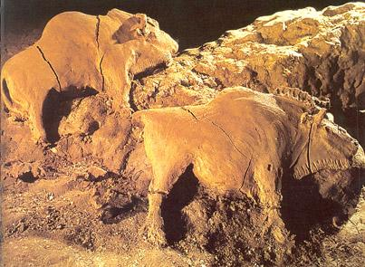
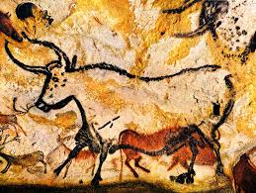
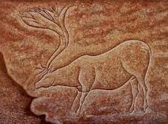
These cave paintings, engravings and carvings are the very first record we have of our ability to create two-dimensional art.

Slide 9
They reveal realistic portraits of the magnificent animals our early ancestors lived alongside, perhaps preyed on, and in some cases most certainly were the prey of.

Slide 10
Some were perhaps created to show how animals were tracked, or to describe herd movements that not only aided hunting, but might also have predicted climate change.
Others may have been created for reasons of sympathetic magic.

Slide 11
LASCAUX, FRANCE
Cave images have been found, such as in the Lascaux caves in southwestern France, that appear to have pockmarks made by pointed spears, possibly thrown in a ritual to “wound” the animal and so ensure future hunting success.

Slide 12
Painted in ochre (yellow) on the cave ceiling Lascaux, France, early period, 15,000-13,500 BC (Dun Horse)

Slide 13
CAVE ART
They drew stick figures for people*, but the animals were well drawn, and usually filled in with natural colors, to give them even more shape and substance.
*Women were drawn with large breasts to represent fertility.

Slide 14
Tour of the Caves in LASCAUX, FRANCE

Slide 15
Early man used natural colors. It looks as if they used charcoal to create many of these paintings. Actually, most art was not made with charcoal, but rather with mineral pigments, such as iron oxide (red ochre) or black manganese.

Slide 16
materials & techniques

